Slide 1
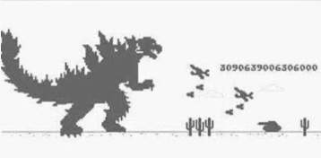
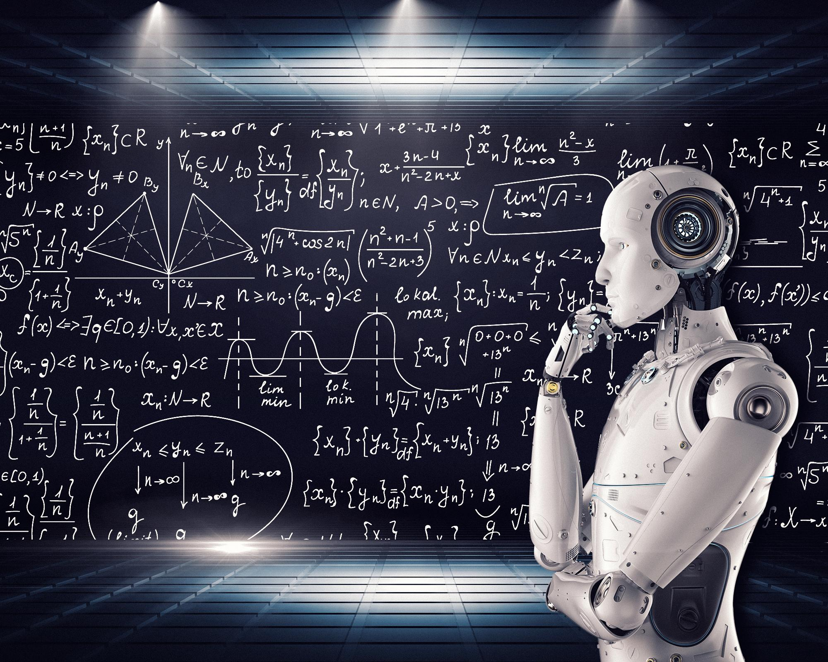
Utilizing A.I. for Self-Learning using the Dino Game
[2]
[1]
By Ramtin Alikhani, Nishant Kaushik, and Joshua Halvorsen.
August 4th 2021
Advanced Technical Elective Project with Ali Tehrani

Slide 2
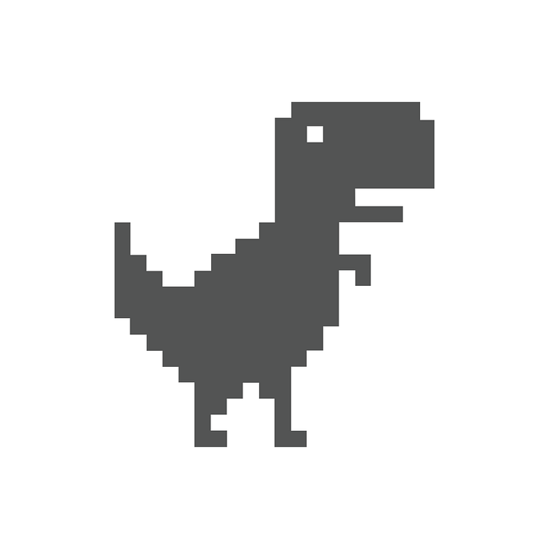

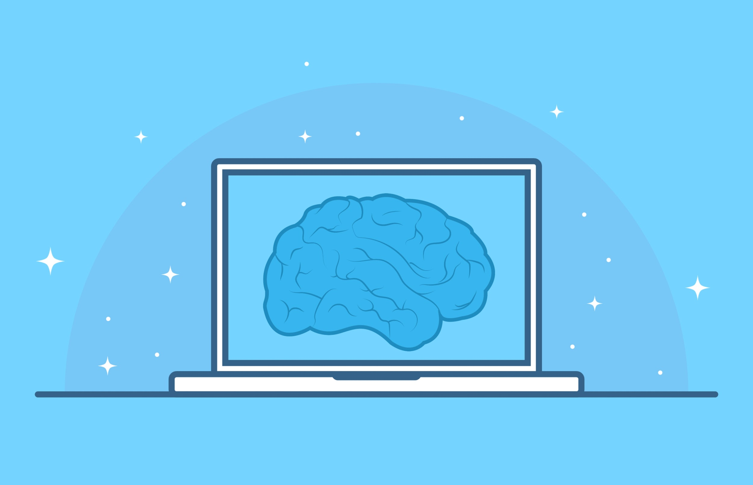
Proposal
Recreate the Google Dino game with the capability of self-learning
Explore 2 different AI algorithms
Integrate the AI with the Game
[1]
[1]

Slide 3



Software
[1]
[1]
[1]
[1]

Slide 4

Algorithms
N.E.A.T Algorithm
[3]
2. Q and Deep Q Learning
[4]

Slide 5
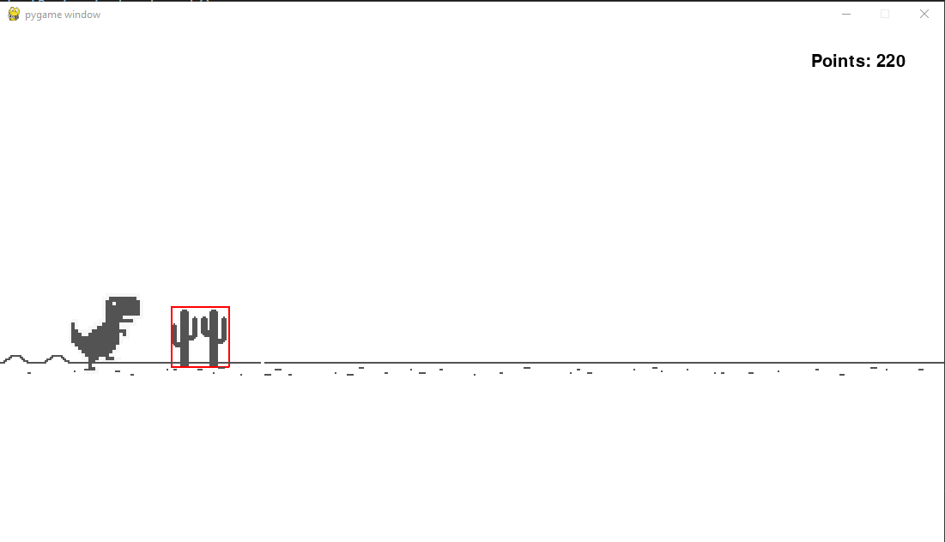
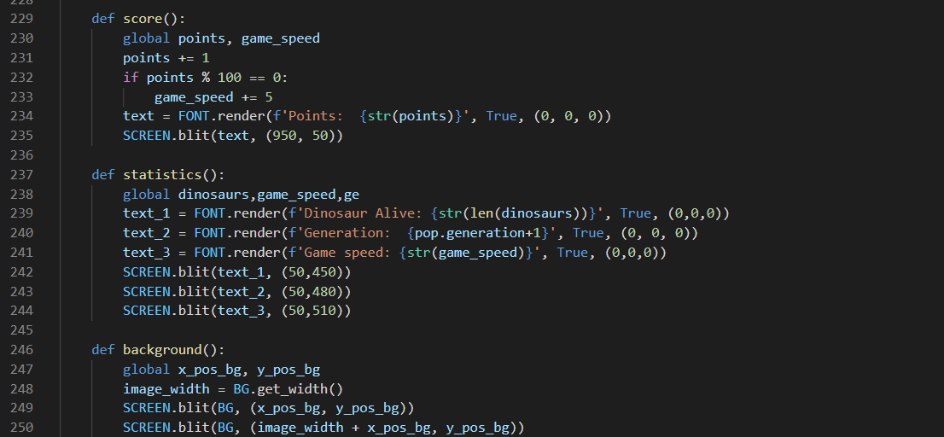
Game Development
Developed from scratch using a youtube tutorial
Windows PC, using Python 3 and PyGame
Initially created game with Keyboard controls
Then created the game with only A.I.
Above and Below: Parts of our progress

Slide 6
Live Demo
Dino Game

Slide 7
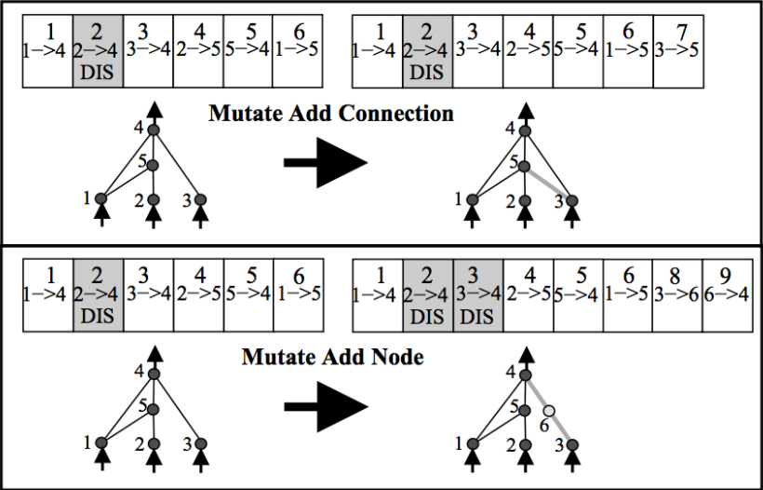
N.E.A.T(NeuroEvolution of Augmenting Topologies)
NEAT is based on an genetic algorithm that creates artificial neural networks
Uses “fitness scores” to define success & failure
Based on Survival of the fittest
Tried networks don’t repeat themselves in the future
Existing networks optimize themselves
Random mutations & crossovers can occur
[5]

Slide 8
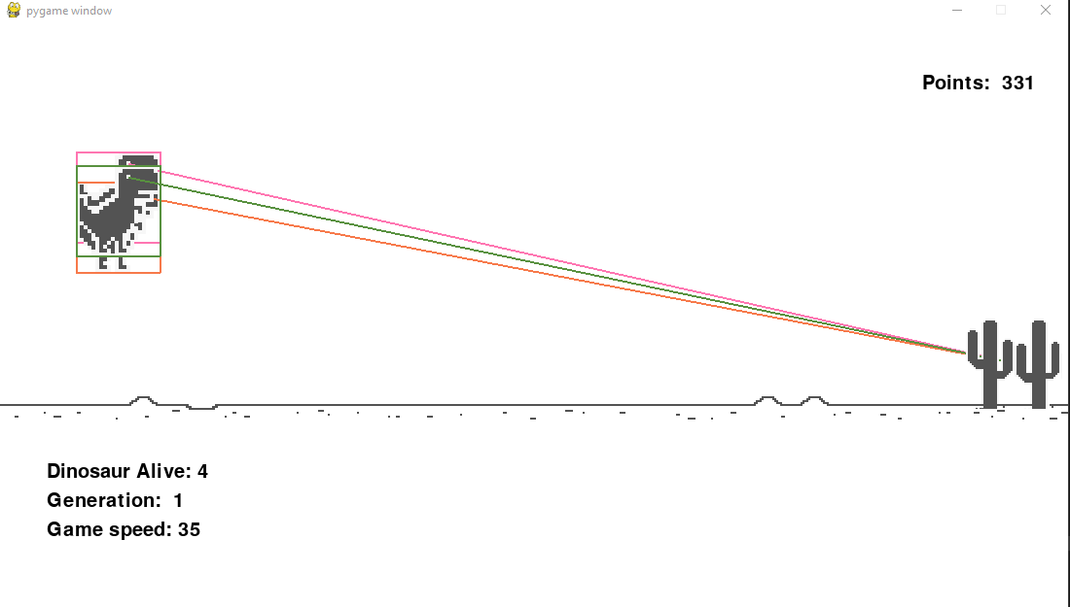
N.E.A.T Implementation in the Dino Game
Start with 100 population
Then as the game progresses until the generation becomes extinct
Previous generation’s best performing dinosaur is used to adjust the weight of the nodes right before the new population is spawned
Dinosaurs looks at the distance from the obstacle
Uses that information to make a decision on whether it should jump or not jump
Above: Our game with NEAT

Slide 9
Live Demo
Dino Game
With
NEAT Algorithm

Slide 10
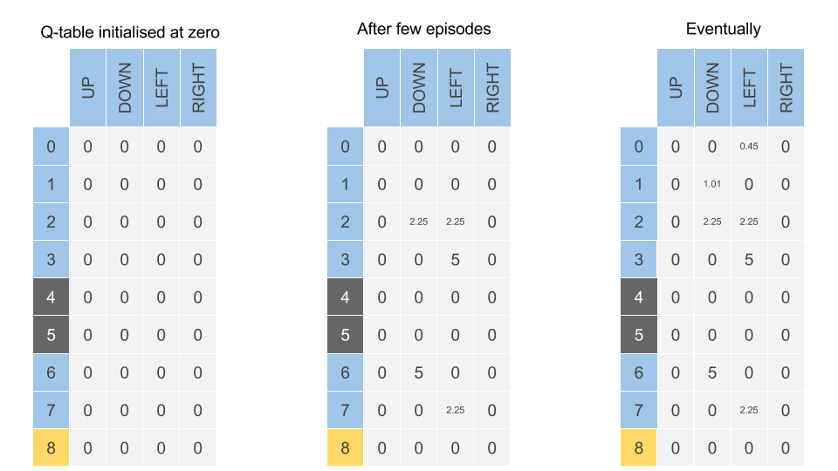

Q Learning - What is it?
Based on reinforcement learning
Good = Reward, Bad = Punishment
State + Action = Q-Value
Q Value indication of “how good” an action is
Highest Q-Value = Best action to take
Series of state-action pairs form Q-Table
Can either act randomly or follow table
Acting random is how the AI “learns”
Uses the Bellman Equation along with the Markov Decision Process
[6]

Slide 11
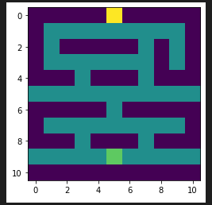
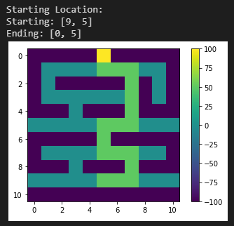
Q Learning - How does it work?
AI given start point and end point in maze and told to navigate start to end as quickly as possible
Can only take 4 actions: Up, Down, Left or Right
AI acts randomly at first, being rewarded at the end and punished for walking into walls or taking too long
AI trains a few thousand times to develop 3D Q-Table
Each square has 4 Q-Values corresponding to possible actions
When given a start point, AI looks at the 4 Q-Values for that square and takes highest value action
Repeats for next square and so on until it reaches the end
Q-Values act as “signposts” pointing towards end point

Slide 12
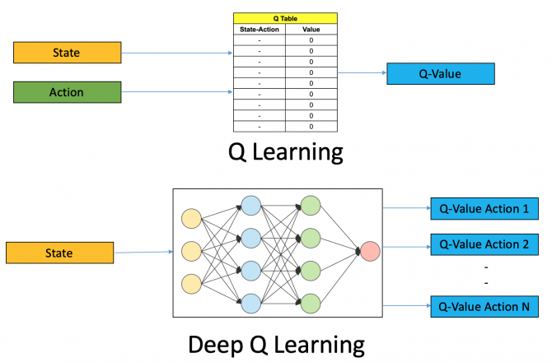
Deep Q Learning - What is it?
Neural network maps inputs to action/Q-Value
Q-Learning maps Q-Value to state/action
Works best in a dynamic environment
Can handle multiple inputs and actions
Inputs connected to decision nodes who “weigh” variables to generate output action Q-Values
Connected via Relu Activation Functions
Choose output action with highest Q-Value
Also uses Bellman Equation, this time to adjust the decision “weights” and node connections
Adjusting decision “weights” and node connections is how this form of AI “learns”
[7]

Slide 13
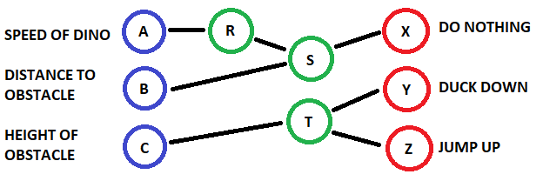
Deep Q Learning - How does it work?
R: Proportionally adjust S based on A to respond sooner due to faster speed
S: Multiply B by R to decide how long to do nothing before reacting to an obstacle
T: If C is low, Y is low and Z is high. Opposite is true if C is high
By adjusting the proportionality from R and the thresholds for T, the AI can be adjusted to better play
Adjusting the decision node weights and the connections is how that AI “learns”
Neural networks can have more layers and many more inputs, decision nodes, actions and connections
Can do much more advanced things such as play Mario Kart or other more “complex” games

Slide 14

Thank You!
Question or Comments?
[1]

Slide 15
References
Images from the google search function within Google slides
Thumbnail of a CGaming youtube channel video
https://www.pinterest.ca/pin/243124079872816625/
https://inews.co.uk/news/technology/james-bonds-q-woman-says-mi6-43554
https://towardsdatascience.com/how-do-we-teach-a-machine-to-program-itself-neat-learning-bb40c53a8aa6
https://towardsdatascience.com/practical-reinforcement-learning-02-getting-started-with-q-learning-582f63e4acd9
https://www.analyticsvidhya.com/blog/2019/04/introduction-deep-q-learning-python/

